Slide 1
Addressing Modes
8051 Programming

Slide 2
Today’s class
Moving data

Slide 3
Three main types
MOV destination, source
PUSH source or POP destination
XCH destination, source

Slide 4
Four addressing modes
Immediate
Register
Direct
Indirect

Slide 5
Memory types
Internal RAM
Internal special-function registers
External RAM
Internal and external ROM

Slide 6
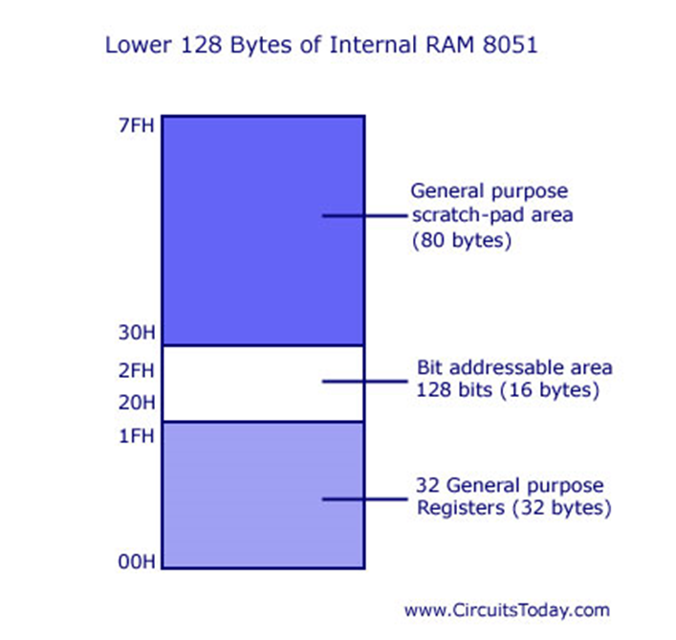

Slide 7
Five types of opcodes
MOV
MOVX
MOVC
PUSH and POP
XCH

Slide 8
Immediate highlights
Source of data only
Instr. using # | Next Byte(s) are data

Slide 9
Immediate Syntax
MOV Rr, #n
MOV A, #n

Slide 10
Immediate Example
MOV R0, #00h
; put the immediate 8 bit
; number 00h in register R0

Slide 11
Immediate Example
MOV A, #0AAh
; put the immediate 8 bit
; number AAh in register A

Slide 12
Immediate Example
MOV R7, #07h
; put the immediate 8 bit
; number 07 in register R7

Slide 13
Register highlights
Instr. Using R0 to R7
Register R0 to R7 in Current Bank
Source or Destination of data

Slide 14
Register syntax
MOV A, Rr
MOV Rr, A

Slide 15
Register Examples
MOV A, #0F1h
MOV R5, A
MOV A, R0

Slide 16
Register Examples
MOV A, #0F1h
; Move the immediate data byte
; F1h to the A register

Slide 17
Register Examples
MOV R5, A
; copy the data in register A
; to register R5

Slide 18
Register Examples
MOV A, R0
; copy the data in register R0
; to register A

Slide 19
Register Examples
MOV R3, #1Ch
;
;

Slide 20
Is this allowed?
MOV #04h, A
; immediate data as a destination

Slide 21
Is this allowed?
MOV A, #FFh
; numbers start with an alphabet

Slide 22
Direct highlights
Instr. Using a RAM address
Address in RAM
Source or Destination of data

Slide 23
Direct syntax and example
MOV A, add
MOV add, #n
MOV add1, add2

Slide 24
Direct example
MOV A, 80h
; copy data from the port 0
; pins to register A

Slide 25
Direct example
MOV R0, 12h
;
;

Slide 26
Direct example
MOV 5Ch, A
;
;

Slide 27
Is this allowed?
MOV 0FAh, A
; addresses above 7Fh

Slide 28
Is this allowed?
MOV 3Ah, 3Ah
; moving data from a direct address
; to itself

Slide 29
Is this allowed?
MOV 3Ah, 3Ah
; moving data from a direct address
; to itself

Slide 30
Indirect highlights
Instr. Using @R0 or @R1
Register R0 or R1 in Current Bank
Address in RAM
Source or Destination of data
Address of data

Slide 31
Indirect Syntax
MOV @Rp, #n
MOV A, @Rp
MOV add, @Rp

Slide 32
Indirect Examples
MOV A, @R0
; copy the contents of the
; address in R0 to the A reg

Slide 33
Indirect Examples
MOV @R1, #35h
;
;

Slide 34
Indirect Examples
MOV @R0, 80h
;
;

Slide 35
Is this allowed?
R0
MOV @R0, #35h
; number in register R0 is
; not a RAM address
FAh

Slide 36
Is this allowed?
MOV @R5, #35h
; using register other than R0 or R1

Slide 37
Summary
Programming with 8051
Lines of code
8051 Instruction Syntax
Labels
Instructions; comments

Slide 38
Summary
Opcodes that move data
Within 8051
8051 and external data memory
Addressing modes
Immediate, register, direct, and indirect.

